Slide 1


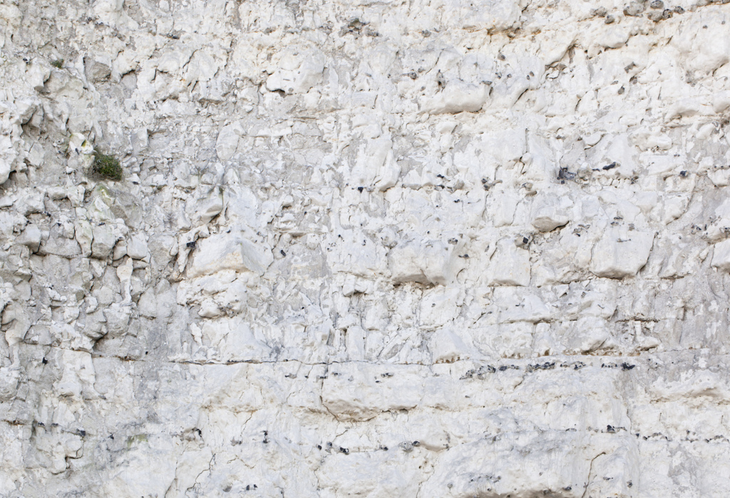
The Hydrogeology of the Chalk
The Geological Society, Burlington House, London. 25th-26th April 2018
A two day conference on the Hydrogeology of the Chalk by the Hydrogeological Group of the Geological Society (supported by the Contaminated Land Group) covering current practice and future challenges on the characterisation and management of Chalk aquifers in the UK and elsewhere.
www.hydrogeologyofthechalk.org.uk rolf.farrell@environment-agency.gov.uk + 44 (0)20302 56723

Slide 2
The conference will focus on applied science and the management of groundwater resources and quality in the Chalk aquifer.
Abstracts, both oral and poster based, are sought for sessions including geology, flow processes, developments in groundwater modelling, regulation and management, extreme events including flooding, climate change and drought, nitrate, saline intrusion, emerging contaminants and more.
Scientific papers should have a clear beneficial conclusion (i.e. not purely work in progress) and all papers should be relevant to the specific peculiarities of chalk hydrogeology!
www.hydrogeologyofthechalk.org.uk rolf.farrell@environment-agency.gov.uk + 44 (0)20302 56723

Slide 3
Features:
Day one focussed on chalk groundwater resources, day two focussed on chalk groundwater quality.
Website with online booking system (coming soon….)
Buffet lunch provided
Student and multi day discount
Drinks reception after each day
Follow up Geological Society Special Publication
www.hydrogeologyofthechalk.org.uk rolf.farrell@environment-agency.gov.uk + 44 (0)20302 56723

Slide 4
Provisional Programme:
Day 1. Chalk Groundwater Resources
  Geology
  Flow processes (recharge, unsaturated zone, saturated zone, SW/GW interaction, modelling)
  Regulation/groundwater management (including WFD, SPZs)
  Extreme events and climate change
Day 2. Chalk Groundwater Quality
  Groundwater quality at the catchment scale (diffusion pollution, aerial nitrate deposition)
  Groundwater quality at the local scale
  Contaminated land
  Ecohydrogeology
www.hydrogeologyofthechalk.org.uk rolf.farrell@environment-agency.gov.uk + 44 (0)20302 56723

Slide 5

Convenors:
Rolf Farrell (Environment Agency)
Paul Howlett (Royal Haskoning DHV)
Angela Haslam (Environment Agency)
Alex Gallagher (WSP)
Rob Low (Rigare)
Adrian Butler (Imperial College)
Abstract submissions to:
abstracts@hydrogeologyofthechalk.org.uk
Deadline 18th December 2017.
See: www.hydrogeologyofthechalk.org.uk for more information
www.hydrogeologyofthechalk.org.uk rolf.farrell@environment-agency.gov.uk + 44 (0)20302 56723

